Slide 1



Slide 2


WHY PURE
HEART - VISION - BUSINESS - MISSION

Slide 3


BUILDING THE NEXT BILLION DOLLAR BRAND TOGETHER

Slide 4
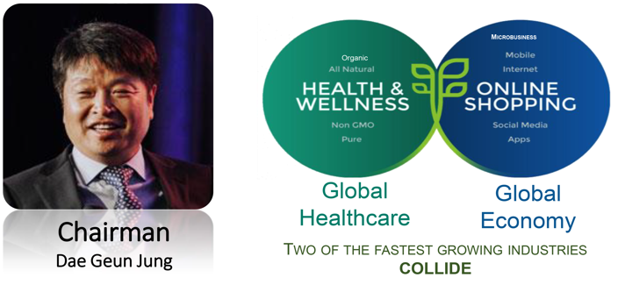
COMPANY HIGHLIGHT - FOUNDER

Slide 5

FACTS ABOUT PURE
12 Successful Years in Business
Frisco, Texas – USA
Global Presence – 12 countries
Over 65 Product Lines
Hi-ACT Principles
~ $100 Million Annual Sales

Slide 6
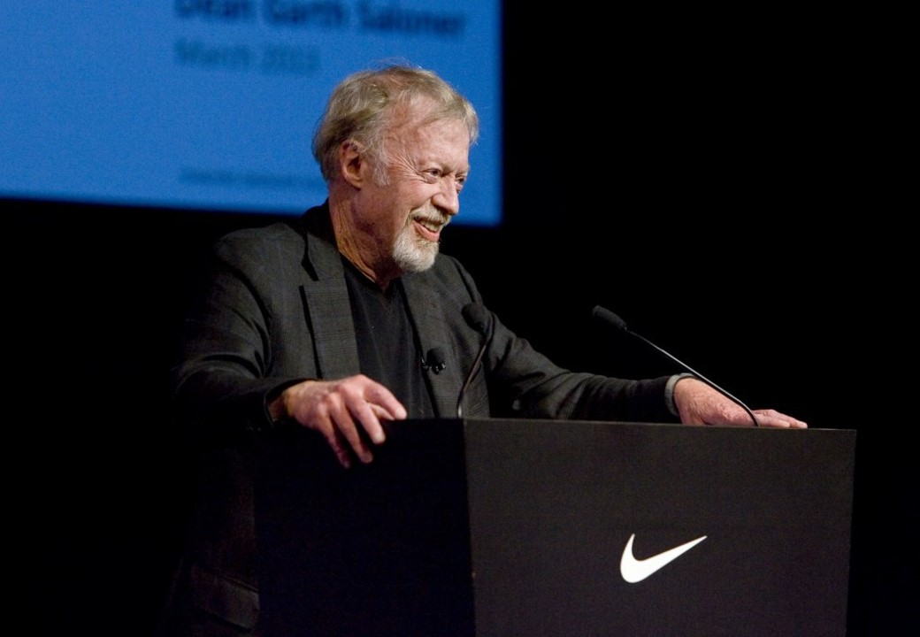

Phil Knight
Founder of Nike
PURE Investor
21st RICHEST MAN IN THE WORLD
(as at October 2019)
Estimated Net-worth: US$37.6 billion
Notes:
6

Slide 7
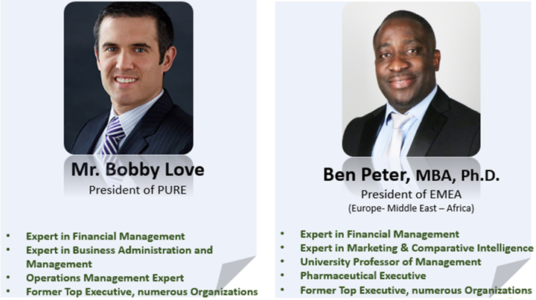
CORPORATE EXECUTIVE

Slide 8
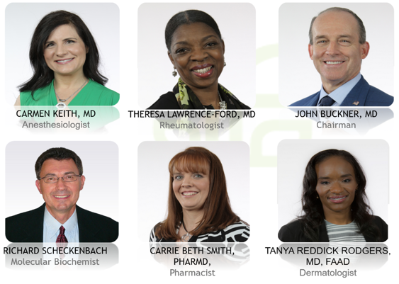
WELLNESS ADVISORY BOARD

Slide 9
PRODUCT LINE
PURE offers over 65 innovative and medical breakthrough products ranging from:
Supplement and Nutritional Support Products
Energy Performance Products
Sport Recovery Products
Skincare and Beauty Products
Liquid Supplement and Coffee Products
Sexual Health Products

Slide 10


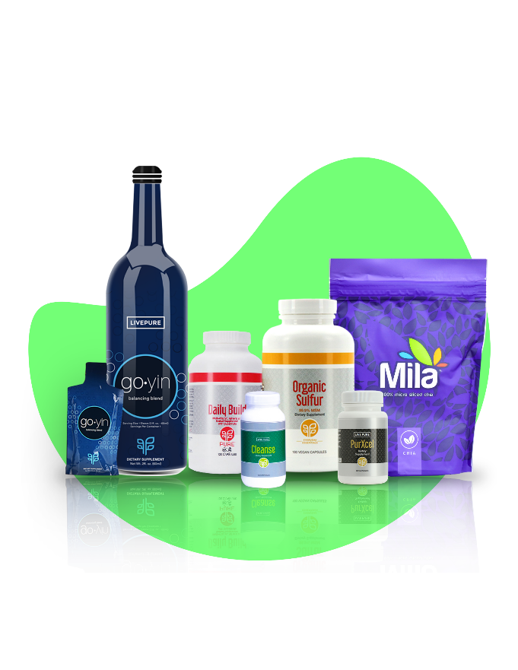

Slide 11
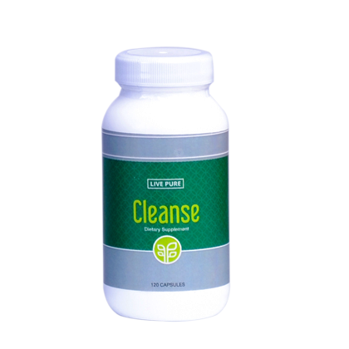
CLEANSE
2020
PHYSICIAN’S
DESK
REFERENCE
PDR.NET
CLEANSE

Slide 12
CLEANSE
Natural Detoxification for the Body
Cleanse has been specially formulated to help
to remove harmful toxins from the body.
The active ingredient :
Cascara Sagrada (an aged, dried extract of Rhamnus purshiana bark ) promotes effective cleansing of the entire body system.

Slide 13
CLEANSE
Cleanses 7 Elimination Pathways
Liver
Lungs
Blood
Skin
Colon
Kidneys
Lymphatic System

Slide 14
BENEFITS OF CLEANSE
It support Digestive Health
It promotes colon Health – Feel clean from the inside
It helps to manage weight loss
It helps to maintain normal intestinal micro flora
It detoxifies the body by flushing out the free radicals Reawakens dead cells and lots more

Slide 15
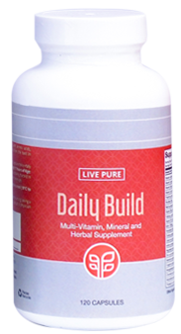
DAILY BUILD
2020
PHYSICIAN’S
DESK
REFERENCE
PDR.NET
DAILY
BUILD

Slide 16
DAILY BUILD
An all-inclusive powerful supplement that is more than just a multi-vitamin
Over 240 ingredients
Balance your diet with the most important vitamins and the highest quality complexes that promotes overall health and maintain optimal balance of vitamins and minerals.

Slide 17
DAILY BUILD
240 PREMIUM NUTRACEUTICALS
Naturally occurring Phyto-nutrients
Fruits and Vegetables
Proprietary Herbs
Beneficial Fibers
Vitamins
Minerals from Whole Foods
Essential Fatty Acids
Amino Acids
Organic Plant Digestive Enzymes

Slide 18
BENEFITS OF DAILY BUILD
General Health and Wellness
Improved Immune System
Supports Healthy Bones
Supports Cardiovascular System
Support Liver and Digestive Systems
Total Systems detoxification of inter-cellular metabolic wastes
Anti Aging System, Longevity and Vibrant Life.
Repairs Muscle, Tissues, Joints, Ligaments and Tendons
Increased Energy, power and mental Acuity
Maintains Nerve Function
Superior Antioxidant
Reduces Free Radical Damage

Slide 19
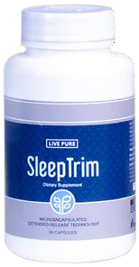
SLEEPTRIM
SLEEP TRIM

Slide 20
SLEEPTRIM
Experience a more restful night’s sleep naturally while supporting your body’s ability to manage weight.
This microencapsulated, extended-release technology slowly delivers a blend of melatonin and blend of capsaicin and red pepper extract to help the body burn calories while you sleep.

Slide 21
BENEFITS OF SLEEPTRIM
It helps with quality sleep.
It helps the body to relax mentally and physically
It helps the body to burn calories naturally during sleep
It delivers melatonin in stages so you can fall asleep and wake up refreshed
It helps the body maintain and manage weight

Slide 22
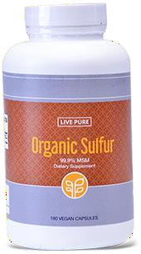
ORGANIC SULFUR
ORGANIC SULFUR

Slide 23
ORGANIC SULFUR
Replenish your body with the highest level of Organic Sulfur
Our Organic Sulfur consists of 99.9% pure distilled
Methylsulfonylmethane (MSM)
No added fillers and binders No artificial ingredients
Non-GMO, gluten-free, dairy-free, and vegan

Slide 24
BENEFITS OF ORGANIC SULFUR
It helps produce collagen(main component of connective tissue)
It supports protein of tendons and supports cartilage
It improves flexibility and mobility by promoting joint function and health.
It promotes healthy bones, cavity and helps the connective
tissues
It helps promote healthy hair gland and nails.
It reduces wrinkles and dryness
It help maintain natural glowing skin and fight against skin conditions such as acne, pimples, psoriasis, vitiligo, blemishes, scare etc.

Slide 25
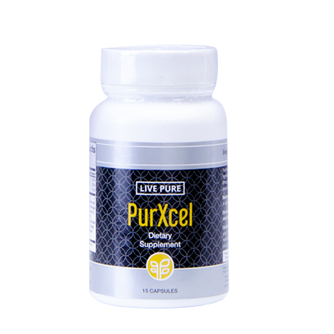

PURXCEL
2020
PHYSICIAN’S
DESK
REFERENCE
PDR.NET
PURXCEL

Slide 26
PURXCEL
PurXcel Tri-active Technology delivers clinically effective:
Bioavailable Glutathione
Superoxide Dismutase (SOD)
Aloe Acemannan
With a proprietary blend of 15 complimentary ingredients designed to help cleanse, balance, and build the body at the cellular level

Slide 27
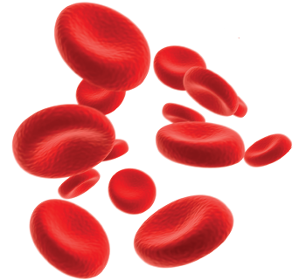
WHY GLUTATHIONE?
The human body contains trillions of cells
We create 40 billion new cells daily
Every single cell needs glutathione to survive!
It is one of the body’s most powerful antioxidant.

Slide 28
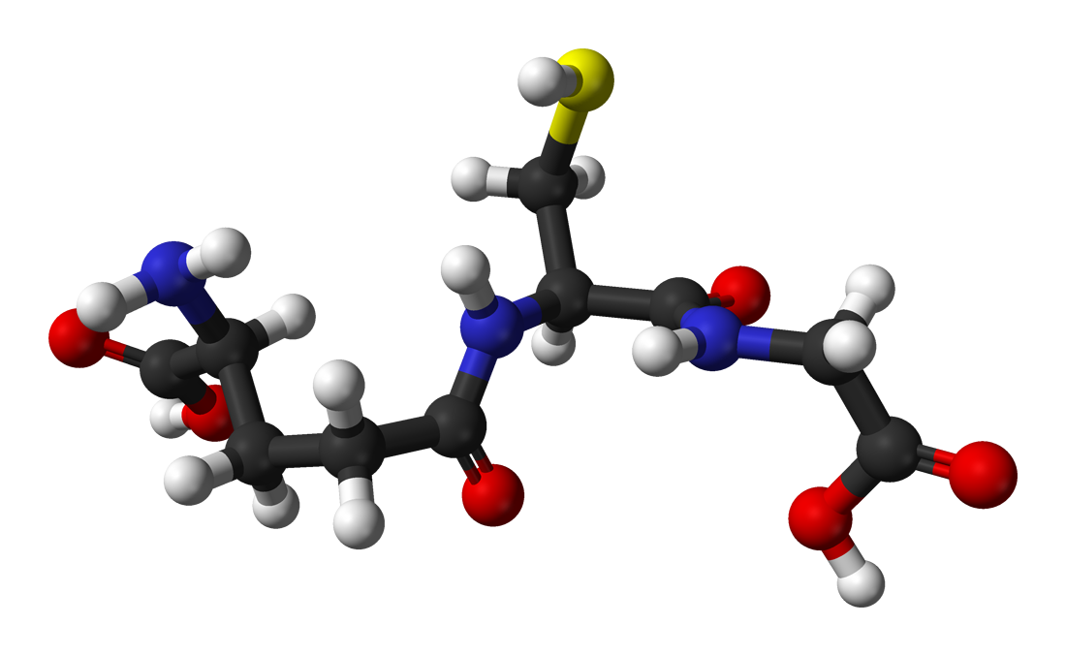
BENEFITS OF GLUTATHIONE
Strengthens the Immune System
Improves Mental Focus, Acuity & clarity
Reduces the harmful effects of stress
Optimize the body’s Energy Level
Detoxifies the body organs and cells
of toxins
Supports better Rest and sleep
Makes one look Younger and skin healthier
Enhances Athletic Ability and Performance
Enhanced Sexual Health and Libido

Slide 29
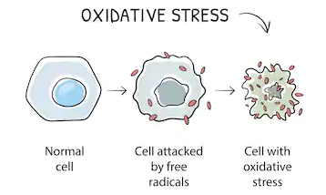
PROBLEM/DEPLETION OF CELLULAR GLUTATHIONE
As we get older, the food we eat, the air we breath and so many things create FREE RADICALS that damage and degrade our cells
It happens through a process called oxidative stress

Slide 30
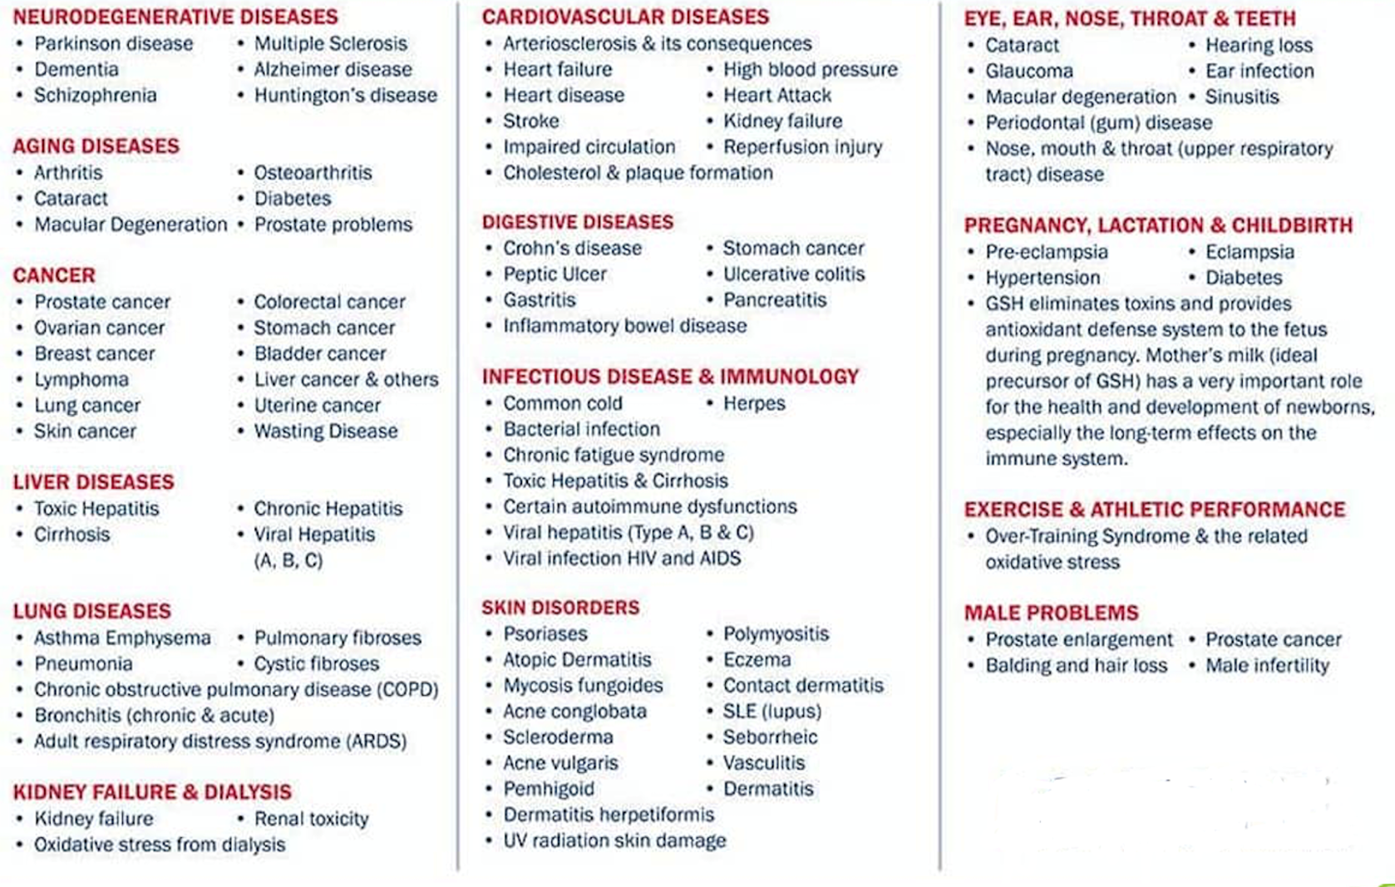
DISEASES ASSOCIATED WITH LOW GLUTATHIONE

Slide 31
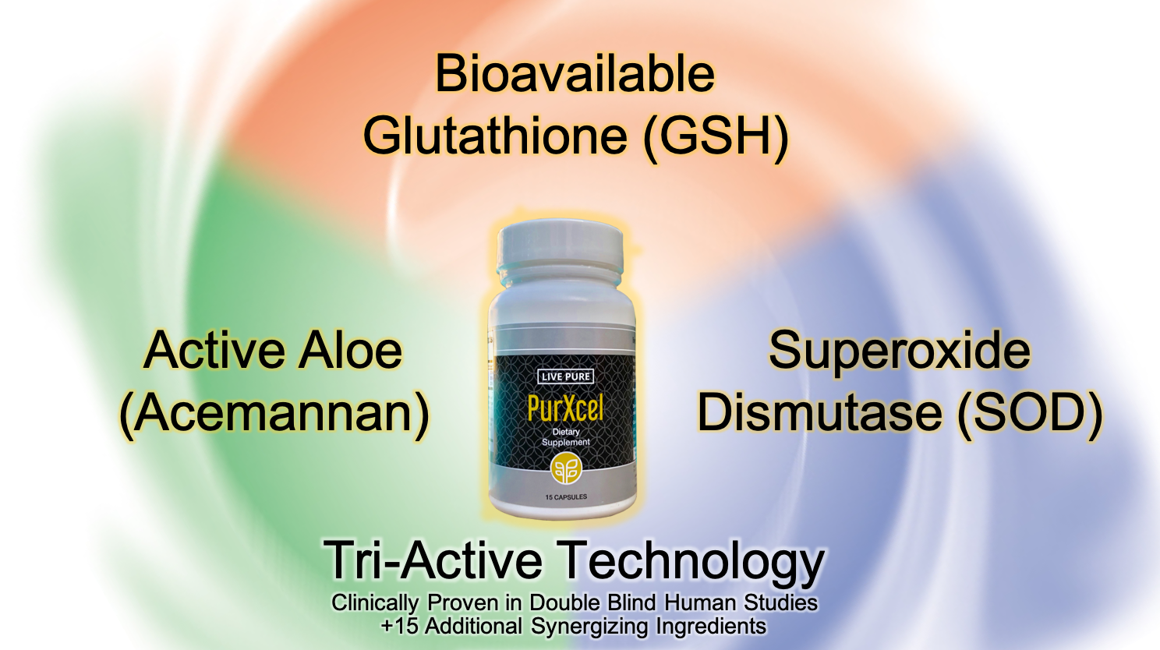
BEYOND GLUTATHIONE

Slide 32
SUPEROXIDE DISMUTASE (SOD)
Superoxide dismutase (SOD) is a primary antioxidant enzymes.
It is a very important antioxidant defense against oxidative stress in the body.
Within our cells, the superoxide dismutases (SODs) constitute the first line of defense against Reactive Oxygen Species (ROS) and Free Radicals.

Slide 33
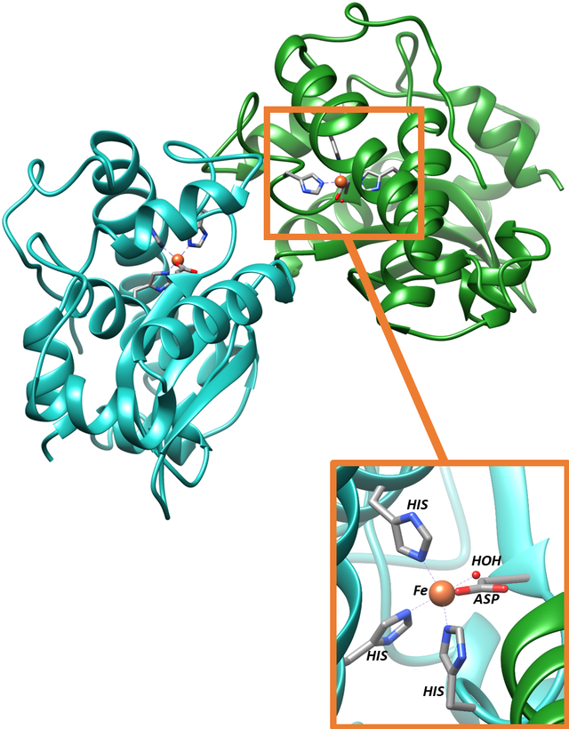
BENEFITS OF SUPER OXIDE DISMUTASE (SOD)
Enhances Joint Health
Enhances Sexual Health
Relieves the body of Physical Pains
Improves Physical Recovery and Wellbeing
Reduces Acne
Helps with UV Protection
Enhances Cellulite Reduction
Enhanced Eye Health

Slide 34

ALOE ACEMANNAN
Acemannan is the main active ingredient and bioactive polysaccharides in the Aloe Vera Plant.
Aloe Acemannan has immuno-stimulant, antiviral, antineoplastic (tumor), and gastrointestinal properties.

Slide 35
BENEFITS OF ACEMANNAN
Modulates the immune system (immuno-regulation)
Accelerates the healing of wounds and burns
Accelerates the healing of ulcers and postsurgical incisions
Has Antineoplastic (tumor) and antiviral effects
Has anti-cancer and an anti-oxidant effects
Promotes bone proliferation
Improves neuro -protection
Promotes intestinal health

Slide 36
COMPLIMENTARY INGREDIENTS
MIKE THISTLE | Milk thistle is sometimes used as a natural treatment for liver problems Lowers cholesterol levels anti-inflammatory and antioxidant
ALPHA LIPOIC ACID | lower blood sugar levels reduced inflammation slowed skin aging improved nerve function
TUMERIC EXTRACT | Has potential to prevent heart disease, Alzheimer's and cancer
MORINGA OLEIFERA LEAF | Lowering of Blood Sugar Levels May Reduce Inflammation Lower Cholesterol
BIOPERINE BLACK PEPPER EXTRACT | Enhances bioavailability Enhances absorption of nutrients by at least 30%.
And Many other ingredients

Slide 37
PROVEN FACTS ABOUT PURXCEL INGREDIENT
Clinically proven human studies- double blind placebo studies
Key Human Studies showed a 325% increase in overall cellular Glutathione Levels
Contains proprietary blend of 15 complimentary ingredients designed to help cleanse, balance, and build the body through glutathione and superoxide dismutase support and production
Over 110 American company trust our Glutathione ingredient
The trusted glutathione ingredient in the world

Slide 38
PURXCEL GLUTATHIONE SUPPORT STUDIES
AUTHORS | STUDIES | RESULTS/FINDINGS
Wu G Fang YZ Yang S Lupton JR Turner ND | Glutathione metabolism and its implications for health | Glutathione plays important roles in antioxidant defense, nutrient metabolism, and regulation of cellular events (including gene expression, DNA and protein synthesis, cell proliferation and apoptosis, signal transduction, cytokine production and immune response, and protein glutathionylation). Glutathione deficiency contributes to oxidative stress, which plays a key role in aging and the pathogenesis of many diseases (including kwashiorkor, seizure, Alzheimer's disease, Parkinson's disease, liver disease, cystic fibrosis, sickle cell anemia, HIV, AIDS, cancer, heart attack, stroke, and diabetes).
Sinee Weschawalit Siriwan Thongthip Phanupong Phutrakool Pravit Asawanonda | Glutathione and its antiaging and antimelanogenic effects | We showed that oral glutathione, 250 mg/d, in both reduced and oxidized forms effectively influences skin properties. Overall, glutathione in both forms are well tolerated.
Over 148,913 clinical studies on PUBMED

Slide 39
PURXCEL SOD SUPPORT STUDIES
AUTHORS | STUDIES | RESULTS/FINDINGS
Milesi MA Lacan D Brosse H Desor D Notin C | Effect of an oral supplementation with a proprietary melon juice concentrate (Extramel) on stress and fatigue in healthy people: a pilot, double-blind, placebo-controlled clinical trial. | The supplementation with the proprietary melon juice concentrate bringing 140 IU SOD/day significantly improved signs and symptoms of stress and fatigue linked to performance, physical (pain, sleep troubles), cognitive (concentration, weariness, sleep troubles) or behavioural (attitude, irritability, difficulty of contact) compared to the placebo. In the same way, quality of life and perceived stress were significantly improved with SOD supplementation.
H. Younus | Therapeutic potentials of superoxide dismutase | The present review describes the therapeutic effects of SOD in various physiological and pathological conditions such as cancer, inflammatory diseases, cystic fibrosis, ischemia, aging, rheumatoid arthritis, neurodegenerative diseases, and diabetes.
Over 81,876 clinical studies on PUBMED

Slide 40
PURXCEL ACEMANNAN SUPPORT STUDIES
AUTHORS | STUDIES | RESULTS/FINDINGS
Sierra-García GD Castro-Ríos R, González-Horta A, Lara-Arias J, Chávez-Montes A | Acemannan, an extracted polysaccharide from Aloe vera: A literature review. | Acemannan has various medicinal properties like osteogenic, anti-inflammatory, and antibacterial, which accelerate healing of lesions. Also, acemannan is known to have antiviral and antitumor activities in vivo through activation of immune responses. It was concluded that Aloe vera has immense potential as a therapeutic agent.
Liu C, Cui Y, Pi F, Cheng Y, Guo Y, Qian H. | Extraction, Purification, Structural Characteristics, Biological Activities and Pharmacological Applications of Acemannan, a Polysaccharide from Aloe vera: A Review. | Acemannan, considered one of the main bioactive polysaccharides of Aloe vera, possesses immunoregulation, anti-cancer, anti-oxidation, wound healing and bone proliferation promotion, neuroprotection, and intestinal health promotion activities, among others.

Slide 41

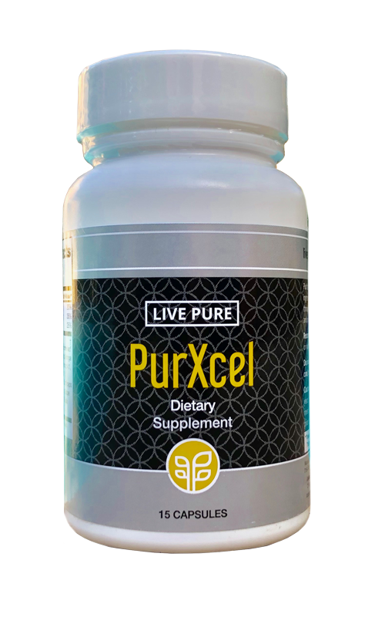
WHAT COULD PURXCEL MEAN FOR ME?
Weight Management
Pain Relief
Sleep Quality
Energy
Fertility
UV Protection
Cognitive Ability
Anti-aging
Cellulite Reduction
Physical Performance
Immunity
Lowers Cholesterol Levels
Anti-inflammatory
Primary Antioxidant
Lowering of Blood Sugar Levels
Bone Proliferation
Antineoplastic
Improves Neuro-Protection
Promotes Intestinal Health
Sexual Performance & Fertility
and lots more

Slide 42




PRODUCT TESTIMONIALS
2020
PHYSICIAN’S
DESK
REFERENCE
PDR.NET

Slide 43
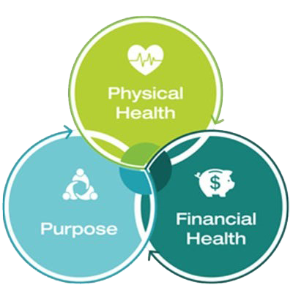
GREAT PRODUCTS = GREAT BUSINESS OPPORTUNITY
PURE BUSINESS OFFERS…
A unique Business opportunity for everyone
The world’s most rewarding compensation plan
Easy to understand

Slide 44


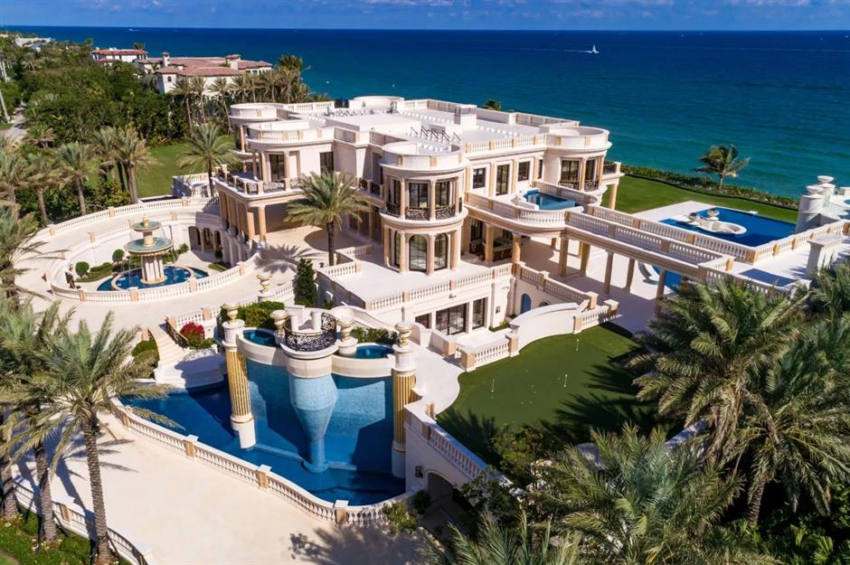

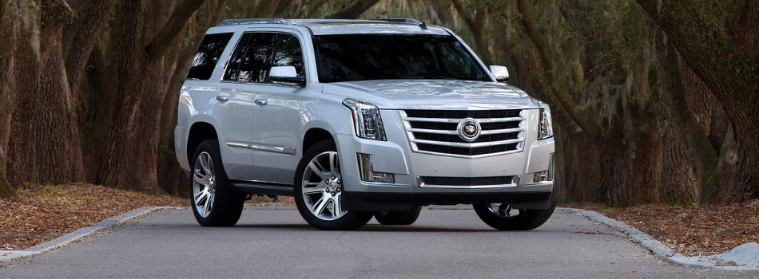


PURE PROSPERITY PLAN
Build the life of your dreams

Slide 45







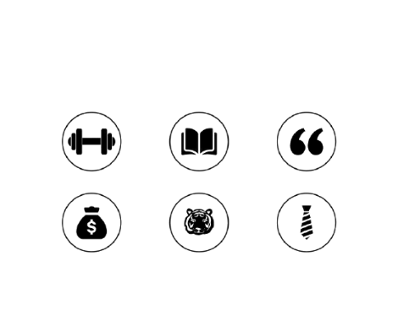



TEN WAYS TO EARN IN PURE
Retail Bonus
Pack Bonus
(Paid Weekly)
Sponsor Bonus
(Paid Weekly)
Team Bonus
(Paid Weekly)
Generational Matching Bonus
(Paid Weekly)
Rank Achievement Bonus
(paid 1 time, + in addition to all earned commissions)
Lifestyle Bonus (paid monthly)
Leadership Bonus
(paid monthly)
Luxury Incentive Trips
Luxury Car Programme

Slide 46

EARNING MATRIX
Starting
point
RETAIL INCOME
Stability
point
MID INCOME
Peak income
point
RESIDUAL INCOME
(Product Sales)
(Sponsor Bonus, Pack Bonus etc)
(Generational Bonus, Shares etc)
RESIDUAL
INCOME
MID
INCOME
RETAIL
INCOME

Slide 47
HOW TO GET STARTED
ENROLLMENT PACKS
 | PV | COMMISSION ACTIVE | PRODUCT UNITS
GHC540 | 50 | 4 Weeks | 2- 12
GHC810 | 100 | 8 Weeks | 4- 24
GHC2,230 | 250 | 12 Weeks | 10- 60
GHC4,325 | 500 | 16 Weeks | 20- 120
RE-ORDER AMOUNT |  |  | Active period
GHC430 | 50PV | 2- 6 Products | 28 DAYS

Slide 48
RETAIL PROFIT
1
Buy Product Packs or any product at wholesale and sell at a retail price.
Retail Price – Wholesale Price = Retail Profit
Example – Daily Build: 270 – GHC215 = GHC55

Slide 49
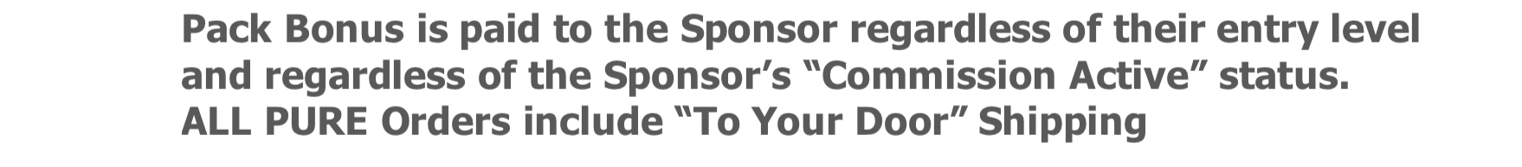
PACK BONUS
2
STARTUP PACKS | PV | COMMISSION ACTIVE | PRODUCT UNITS | PACK BONUS
GHC540 | 50 | 4 Weeks | 2- 12 | GHC75
GHC810 | 100 | 8 Weeks | 4- 24 | GHC150
GHC2,230 | 250 | 12 Weeks | 10- 60 | GHC300
GHC4,325 | 500 | 16 Weeks | 20- 120 | GHC500
PACK BONUS IS PAID WEEKLY

Slide 50
SPONSOR BONUS
3
Sponsor Bonus is paid weekly.
When you enroll a new PURE IBO, you will receive 10% of their
product order PV during their first 90 days.
ENROLLMENT PACKS | PV | COMMISSION ACTIVE | PRODUCT UNITS | SPONSOR BONUS
GHC540 | 50 | 4 Weeks | 2- 12 | GHC25
GHC810 | 100 | 8 Weeks | 4- 24 | GHC50
GHC2,230 | 250 | 12 Weeks | 10- 60 | GHC125
GHC4,325 | 500 | 16 Weeks | 20- 120 | GHC200
SPONSOR BONUS IS PAID WEEKLY

Slide 51
TOTAL IMMEDIATE BONUS
When you enroll a new PURE IBO, you receive this total Bonus.
ENROLLMENT PACKS | PV | COMMISSION ACTIVE | PRODUCT UNITS | SPONSOR BONUS | PACK BONUS | TOTAL BONUS
GHC540 | 50 | 4 Weeks | 2- 12 | GHC25 | GHC75 | GHC100
GHC810 | 100 | 8 Weeks | 4- 24 | GHC50 | GHC150 | GHC200
GHC2,230 | 250 | 12 Weeks | 10- 60 | GHC125 | GHC300 | GHC425
GHC4,325 | 500 | 16 Weeks | 20- 120 | GHC250 | GHC500 | GHC750

Slide 52







TEAM BONUS (BINARY TREE)
4
Your personal Sales Organization is divided into two teams. Based on your Leadership Rank you may earn 10% of the Product Volume (PV) in your lesser team volume or “Pay” Team.
YOU
You earn
10%
in your LTV
BTV
Bigger
team
LTV
Lesser
team
(Pay Team)
David
Tony
John
Johny
To qualify for the TEAM Bonus, you must generate a minimum of 50PV every 4 weeks to be Commission Active, and enroll two people, one Commission Active person on your left and right.
TEAM BONUS IS PAID WEEKLY

Slide 53

TEAM BONUS (EXAMPLE)
Left (BTV) Right (LTV)
3300 PV 3000PV
(including spill over)
150PV
500PV
1000PV
100PV
1000PV
1500PV
50PV
500PV
= Spill over volume
500PV
LTV = Lesser Team Volume
BTV= Bigger Team Volume
1000PV
You would be paid 10% of your LTV E.g. 3,000 PV = $300 (GHC1,500)

Slide 54
HOW TO ACHIEVE RANK
RANK | LTV | STV |  | Max STV/Leg | Weekly Potential Income Range**
IBO | Retail Bonus, Sponsor Bonus, and Pack Bonus
BRONZE | 500 PV |  | - | - | GHC250 – GHC5,000
SILVER | 1500 PV |  | 2000 PV | 1500 PV | GHC750 – GHC5,000
GOLD | 3000 PV |  | 4000 PV | 3000 PV | GHC1,500 – GHC7,500
PLATINUM | 5,000 PV |  | 7,000 PV | 5,000 PV | GHC2,500 – GHC15,000
SAPPHIRE | 7,500 PV |  | 10,500 PV | 7,000 PV | GHC5,750 – GHC20,000
RUBY | 10,000 PV |  | 15, 000 PV | 10,000 PV | GHC5,000 – GHC30,000
EMERALD | 15,000 PV |  | 20,000 PV | 13,000 PV | GHC7,500 – GHC40,000
DIAMOND | 20,000 PV |  | 35,000 PV | 15,000 PV | GHC10,000 – GHC62,500
BLUE DIAMOND | 30,000 PV |  | 50,000 PV | 20,000 PV | GHC15,000 – GHC125,000
PRESIDENTIAL BLACK DIAMOND | 30,000 PV |  | 75,000 PV | 25,000 PV | GHC15,000 - UNLIMITED
CHAIRMAN BLACK DIAMOND | 30,000 PV |  | 150,000 PV | 50,000 PV | GHC15,000 - UNLIMITED
AMBASSADOR BLACK DIAMOND | 30,000 PV |  | 300,000 PV | 100,000 PV | GHC15,000 - UNLIMITED
CROWN DIAMOND | 30,000 PV |  | 500,000 PV | 125,000 PV | GHC15,000 – UNLIMITED
*Team + Generational

Slide 55
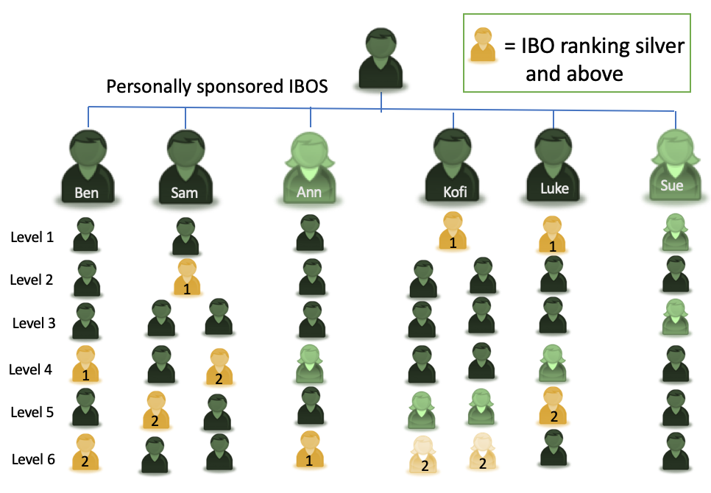
GENERATIONAL BONUS (SPONSOR TREE)
5
RANK/BONUS | Gen. 7% Match
GOLD | 1
PLATINUM | 2
SAPPHIRE | 3
RUBY | 4
EMERALD | 4
DIAMOND | 5
BLUE DIAMOND | 6
PRESIDENTIAL BLACK DIAMOND | 7
CHAIRMAN BLACK DIAMOND | 8
AMBASSADOR BLACK DIAMOND | 9
CROWN DIAMOND | 10
You
Based on your weekly Paid Rank you will receive a 7% MATCH on the Team Bonus of IBO’s in your Sponsor Team down through and including up to 10 Generations of Silver and above ranked leaders

Slide 56
RANK BONUS
6
CROWN DIAMOND
GHC1,250,000
AMBASSADOR
BLACK DIAMOND
GHC750,000
CHAIRMAN
BLACK DIAMOND
GHC187,500
PRESIDENTIAL
BLACK DIAMOND
GHC87,500
BLUE DIAMOND
GHC62,500
DIAMOND
GHC37,500
EMERALD
GHC18,750
RUBY
GHC12,500
SAPPHIRE
GHC6,250
PLATINUM
GHC5,000

Slide 57
LIFESYTLE BONUS
7
* The LIFESTYLE BONUS is payed on the highest qualified rank achieved twice within a calendar month.
RANK | LIFESTYLE BONUS*
BRONZE | GHC250/Month
SILVER | GHC750/Month
GOLD | GHC1,500/Month
PLATINUM | GHC2,500/ Month
SAPPHIRE | GHC3,750/Month
RUBY | GHC4,500/Month
EMERALD | GHC5,500/Month
Example:
Week 1: Gold, Week 2: Sapphire, Week 3: Platinum, Week 4: Ruby
Lifestyle Bonus would pay out Sapphire – GHC3,750

Slide 58
LEADERSHIP BONUS
8
Based on your Monthly or weekly Paid Rank you will receive a specific dollar bonus amount monthly, OR between 1 and 10 Shares weekly of a 3% global pool of the PURE Total Company Volume
Leadership bonus is currently paying out approximately $1,000 per share – imagine $10,000 US per week!!
LEADERSHIP RANK | SHARES OF POOL | APPROX. VALUE OF SHARE
DIAMOND | 1 | GHC5,000/week
BLUE DIAMOND | 2 | GHC10,000/week
PRESIDENTIAL DIAMOND | 3 | GHC15,000/week
CHAIRMAN | 4 | GHC20,000/week
AMBASSADOR | 6 | GHC30,000/week
CROWN DIAMOND | 10 | GHC50,000/week

Slide 59


LUXURY INCENTIVE TRIPS
9
BAHAMAS
CANADA
PARIS
UNITED STATES
DUBAI
ITALY
LONDON
DIAMOND TRIPS
CRUISE TRIPS
PERU

Slide 60





LUXURY CAR PROGRAMME
10
Hit the rank of DIAMOND and be eligible
to participate in this car partnership programme.
T & C Applies

Slide 61
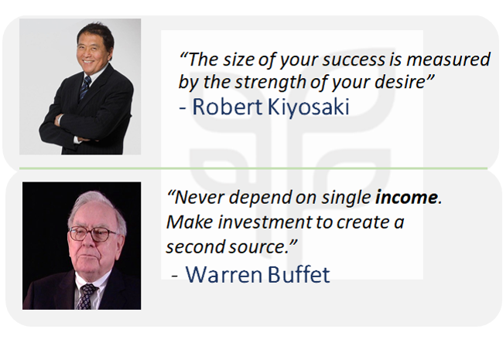
FINANCIAL TESTIMONIALS

Slide 62

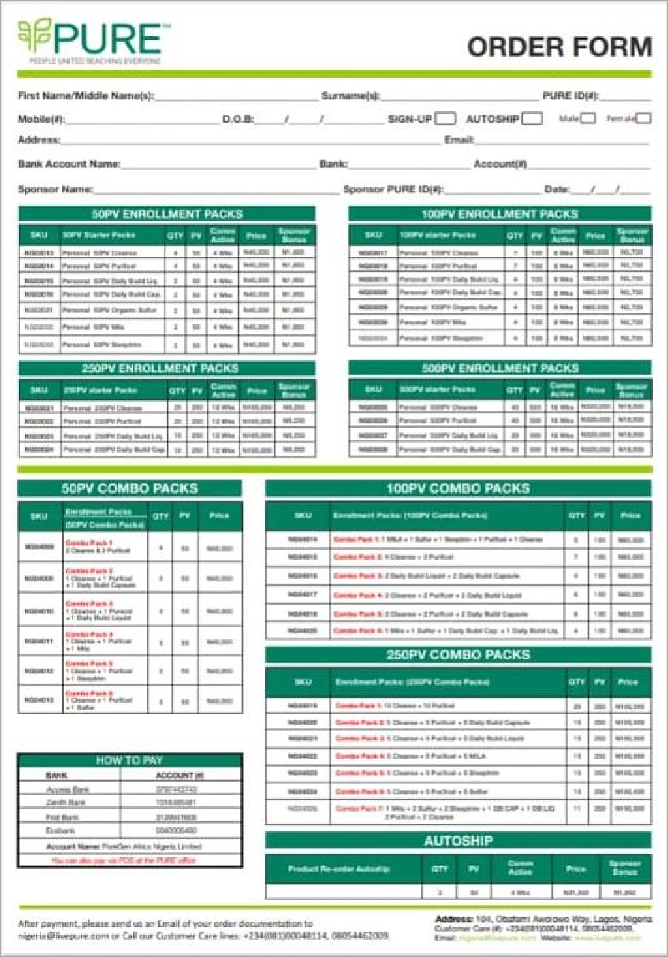
START YOUR JOURNEY TO
FINANCIAL FREEDOM
ACCOUNT DETAIL
ACCOUNT NAME:
PUREGEN GHANA LTD
ACCOUNT NUMBERS: ECO BANK – 1441001094408 GTBANK – 201118496110
MTN MoMo DETAILS
No: 0248735635 Name: Frederick Kobina Ansah Afful

Slide 63
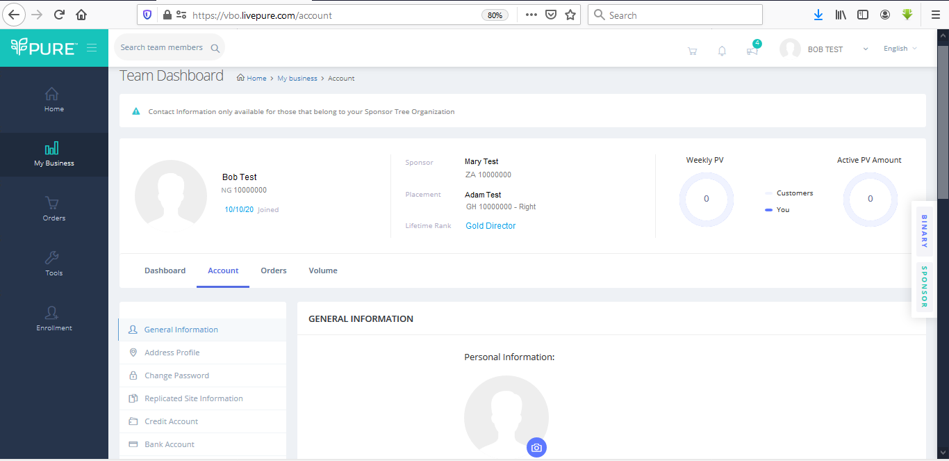
HOW TO UPDATE YOUR ADDRESS OR BANK ACCOUNT DETAILS VIA YOUR BACK OFFICE
Log into your Virtual Back Office (VBO)
And click ‘My Business’.
under ‘My Business’ click on ‘Team Dashboard’

Slide 64
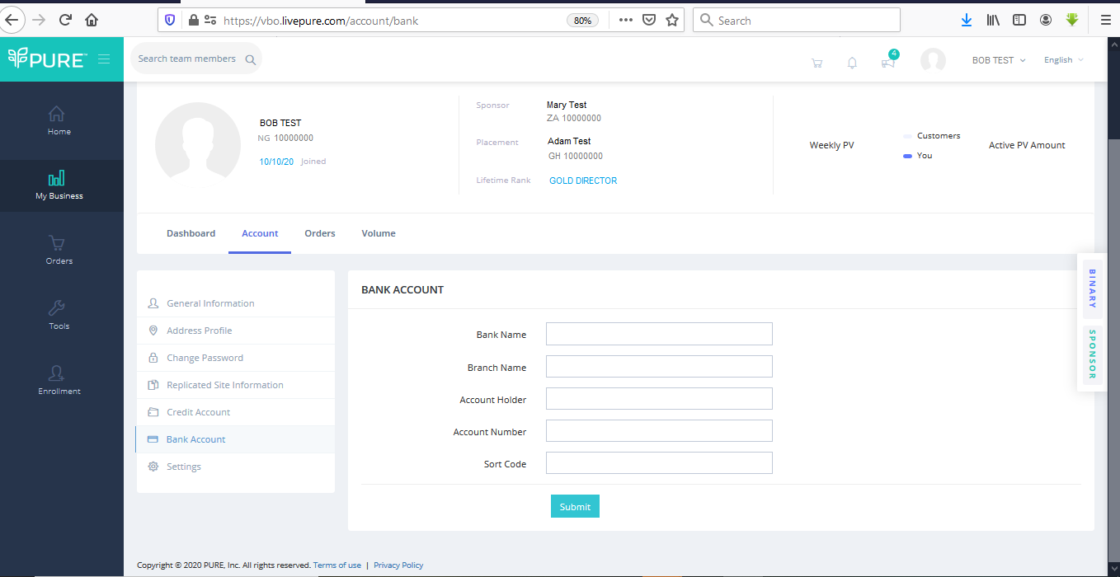
HOW TO UPDATE YOUR ADDRESS OR BANK ACCOUNT DETAILS VIA YOUR BACK OFFICE
Under ‘Team Dashboard’
click on ‘Bank Account’
Input correct bank
Account details here
To update shipping address or Billing Address, Click on ‘Address Profile’ on the left panel

Slide 65


